Slide 1
Model-based Software Engineering
師大資工
鄭永斌

Slide 2
History
While dealing with complex entity, other engineering has learned not to learn it by building it.
They approach the complexity cautiously
Building prototypes and models are two major approaches for tackling with something we do not understand much

Slide 3
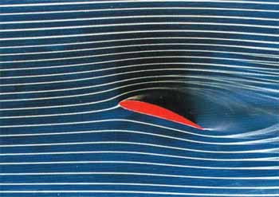

Prerequisite (1)
In other engineering fields
  In aircraft manufacturing, engineering build model to test air dynamics in a wind tunnel
NASA's cryogenic wind tunnel simulates flight conditions for scale models--a critical tool in designing airplanes.

Slide 4
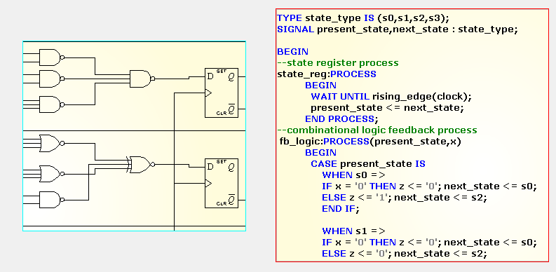
Prerequisite (2)
In E.E., they always simulate their design
first before manufacturing
VHDL

Slide 5
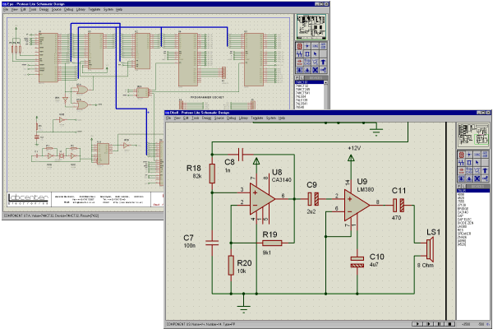
Prerequisite (3)
Software tools/environment for simulation and verification of hardware design

Slide 6



How about software?
coding
idea
Software Crisis
Poor Quality
(particularly in Taiwan)
No body has faith in Software

Slide 7



Software Engineering Methodology
idea
Requirement and Spec
Modeling and Design
coding

Slide 8

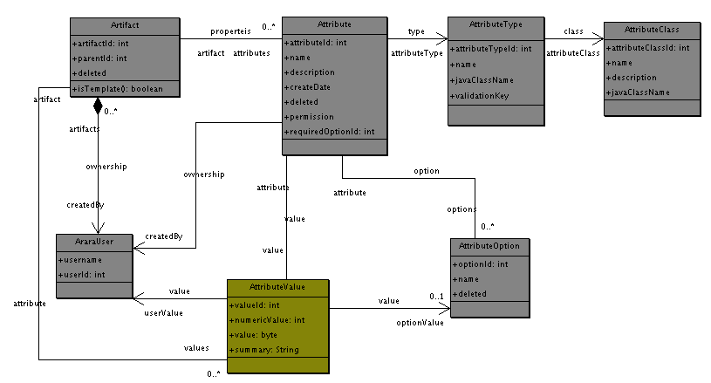
Modeling Technology
UML (Unified Modeling Language)

Slide 9
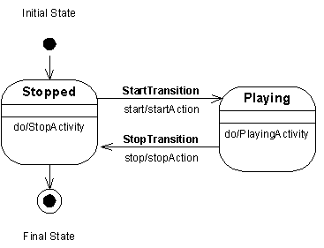
State Chart in UML
To describe the behaviors of a single object or composite behaviors of objects based on state/event model
executable

Slide 10
Types of models
As in different engineering discipline, there are different kinds of models
In software development, actually you have use some non-standard models without noticing it.
  Flow chart
  Data flow graph
  Architecture models

Slide 11
Model classification based on rigidity
  Model that is not rigid
    Some UML models like class diagram
    ERD models
  Model that is executable
    State chart in UML, can be applied to tools such as simulation
  Model that is rigid
    Can be applied to tools such as verification

Slide 12
Model classification based on application domain
Object-Oriented models (UML)
Concurrency models (finite-state like)
  CCS, CSP (Communicating Sequential Process)
  Petri Net
Data models
  ERD (entity relationship diagram)

Slide 13
Modeling process
Actually, modeling process is a design and analysis process
Through the process, you will understand, research, and consider your problem carefully. Therefore, avoid fatal error in your problem

Slide 14
Modeling process
Modeling process is not omniscient
  A possible scenario is that
    You build models
    You use tools to verify, validate the models and prove your design is correct
    You have programmers follow your model to implement the system
    Your system still crash!

Slide 15
  However, the scenario is no different in some disciple
    You build models
    You use tools to verify, validate the models and prove your design is correct
    You have your design manufactured
    Your products do not work

Slide 16
Modeling process
However, modeling process enforces you to think, research, and understand your problem
Although your programmers may still build a poor quality code according to your design
At least, your architecture, design maintained in good shape.
也就是說你還保持著你的概念的完整性

Slide 17
What can you do to a model?
Check consistency or Proofs
Translate it into templates, allow programmers to add codes
Check functional correctness –
  Simulation – if the type of model is executable
  Verification – if the type of model is based on some formalism
Use it as document (Software Visualization)
Use it as a communicating tools

Slide 18
Check consistency and Proofs
The major risk of design and analysis is omit specification
There are other tools to prove a model’s correctness – manual help is needed, semi-automatically

Slide 19
Translate a model into templates for coding
These tools are practical and really used in practice
  Rationale
  ArgoUML
  JBuilder X

Slide 20
Check functional correctness
Consider the EE process again.
  A model is mostly useful if it can help discover your design flaws in early stage
Software engineering community always want that !! And want it hard!!!
They want some models which can be validated or verified

Slide 21
The basics
Testing – execution on product or program (implementation) to detect faults (optimistic)
Simulation – execution on artifacts (models) which is simpler representation of the original complexity (optimistic)
Verification – explore all the state space of models which is a simpler representation of original complexity (pessmistic)

Slide 22
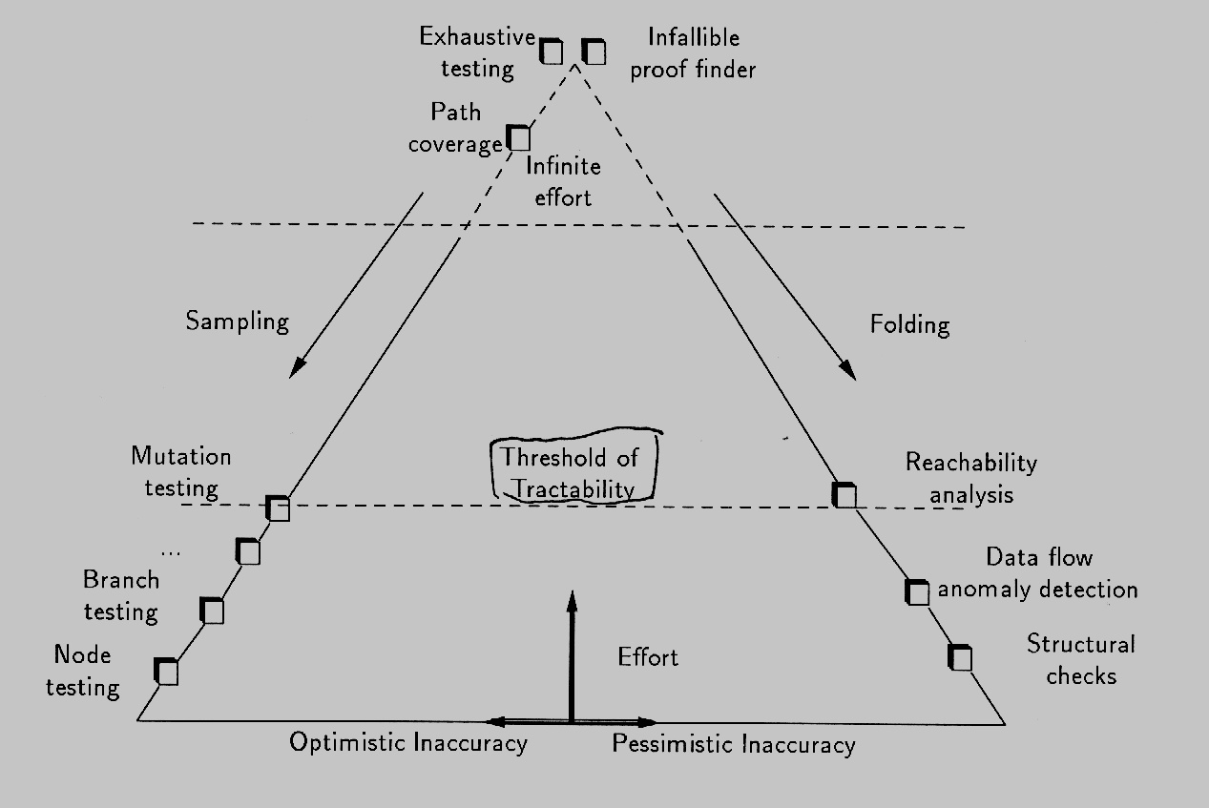
Optimistic v.s. Pessimistic
Optimistic

Slide 23
Models
So, we want models can be
  Simulated!
  Verified !
They can provide more clues of how our design is wrong
By the way, what is design?

Slide 24
The foundation behind model simulation and verification
X ≤ Y
(X > -1) => (Y>-1)
Preorder
(implements)
Prog
≤
Model
deadlock exist ⇒ deadlock exists

